Slide 1
DEPARTMENT OF COMPUTERSCIENCE & ENGINEERING M. Tech (CSE) – Second Semester(Term:June-Sep) NON-CIE COMPONENT
Universal set of gates
Quantum Computing(MCS22)
Presented By:
Meena.N

Slide 2

Universal set of gates
A small set gates (e.g AND,OR,NOT) Can be used to compute an arbitrary classical function such a set of gates is universal for classical computation.
Any other unitary operation can be expressed as a finite sequence of gates from the set.
Ex: nand is universal

Slide 3


In quantum computing, to implement any unitary operation on n qubits exactly requires an infinite number of gates types.&to reduce quantum operation.
The set of all 2-input gates is universal
-Any n-quit unitary operation can be implemented
using
CNOT and the (infinite) set of all 1-qubit gates is universal.
where , I=identity matrix

Slide 4

Two-level unitary gates are universal
Consider a unitary matrix U which acts on a d-dimensional Hilbert space. In this explain how U may be decomposed into a product of two-level unitary matrices; that is, unitary matrices which act non-trivially only on two-or-fewer vector components.
Two-level unitary matrices U1,...,U3 such that
Inverse of unitary matrices
To break U up into a product of two-level unitary matrices
.

Slide 5



Use the following procedure to construct : if b = 0 then set

Slide 6
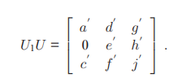

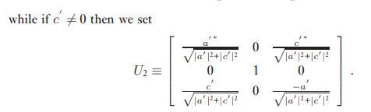
Note that in either case U1 is a two-level unitary matrix, and when we multiply the matrices out we get

Slide 7
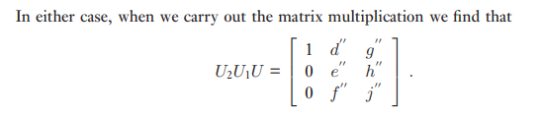

Since U, U1 and U2 are unitary, it follows that U2U1U is unitary, and thus d ”= g’’ = 0, since the first row of U2U1U must have norm 1. Finally, set

Slide 8
Single qubit and gates are universal
An arbitrary unitary matrix on a d-dimensional Hilbert space may be written as a product of two-level unitary matrices.
Now we show that single qubit and gates together can be used to implement an arbitrary two-level unitary operation on the state space of n qubits.
Combining these results we see that single qubit and gates can be used to implement an arbitrary unitary operation on n qubits, and therefore are universal for quantum computation.
Ex: implement the two-level unitary transformation

Slide 9
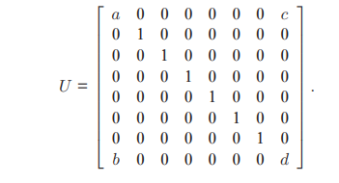

Slide 10
Notice that U acts non-trivially only on the states |000> and |111>. We write a Gray code connecting 000 and 111:
A B C
0 0 0
0 0 1
0 1 1
1 1 1
The first two gates shuffle the states so that |000> gets swapped with |011>. Next, the operation U˜ is applied to the first qubit of the states |011>and |111>, conditional on the second and third qubits being in the state |111>. Finally, we unshuffle the states, ensuring that |011>gets swapped back with the state |000>.

Slide 11
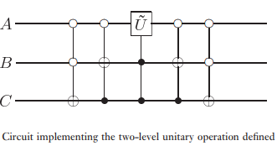
Each of these controlled operations can be realized using O(n) single qubit and gates; Thus, implementing U requires O(n²) single qubit and gates.
Results in arbitrary unitary operation on n qubits can be implemented using a circuit containing O(n²4ⁿ) single qubit and gates.

Slide 12
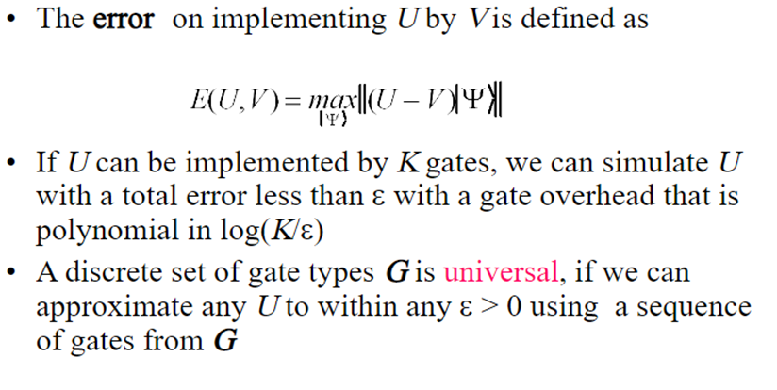
Discrete set of quantum gates
we proved that the single qubit unitaries together form a universal set for quantum computation. Unfortunately, no straightforward method is known to implement all these gates in a fashion which is resistant to errors.

Slide 13

Qiskit
Hadamard gate (H-gate) :It is a fundamental quantum gate. It allows us to move away from the poles of the Bloch sphere and create a superposition of |0⟩|0⟩ and |1⟩|1⟩. It has the matrix:
We can see that this performs the transformations below:
H|0⟩=|+⟩ H|1⟩=|−⟩

Slide 14
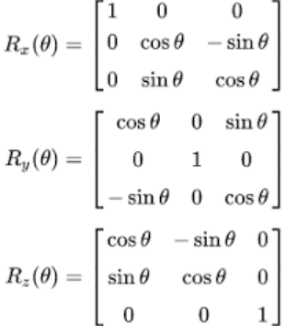
Rotation matrix
This method works because the x and y axis are orthogonal, which causes the x gates to flip the direction of the rotation. It therefore similarly works to make a controlled Rz(θ)Rz(θ). A controlled Rx(θ)Rx(θ) could similarly be made using CNOT gates

Slide 15
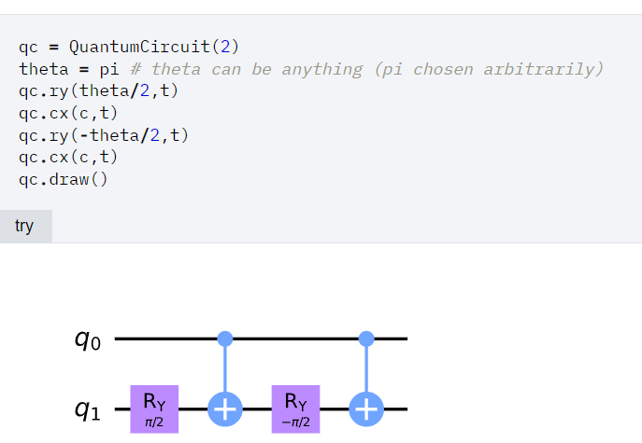

Slide 16
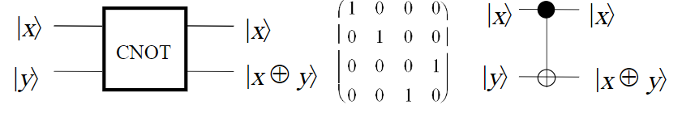
CNOT (Controlled not)
The rotation operators R_{x}(θ), R_{y}(θ), R_{z}(θ), the phase shift gate P(φ) and CNOT form a widely used universal set of quantum gates.

Slide 17
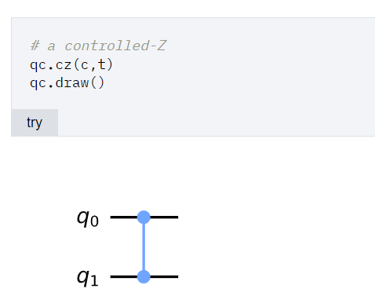
Making a Controlled-Z from a CNOT
The controlled-Z or cz gate is another well-used two-qubit gate. Just as the CNOT applies an XX to its target qubit whenever its control is in state |1⟩|1⟩, the controlled-ZZ applies a ZZ in the same case.

Slide 18
The process for this is quite simple. We know that the Hadamard transforms the states |0⟩|0⟩ and |1⟩|1⟩ to the states |+⟩|+⟩ and |−⟩|−⟩ respectively. We also know that the effect of the ZZ gate on the states |+⟩|+⟩ and |−⟩|−⟩ is the same as that for XX on the states |0⟩|0⟩ and |1⟩|1⟩ respectively. From this reasoning, or from simply multiplying matrices, we find that
HXH=Z,HZH=X

Slide 19
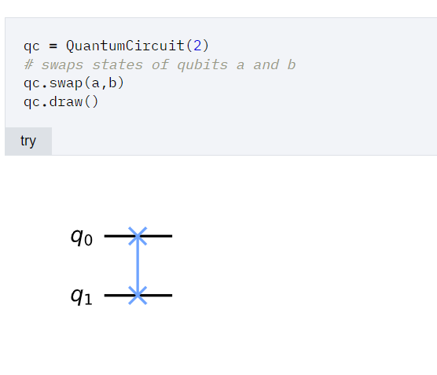
Swapping Qubits
Sometimes we need to move information around in a quantum computer. For some qubit implementations, this could be done by physically moving them. Another option is simply to move the state between two qubits. This is done by the SWAP gate.

Slide 20
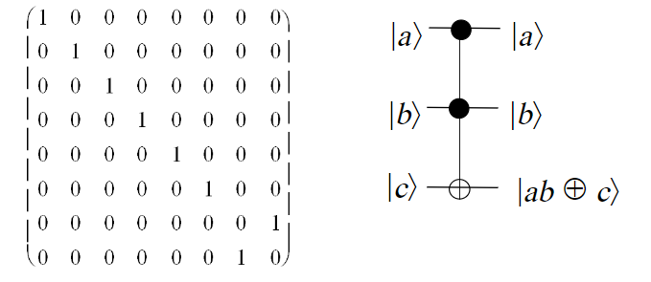
Toffoli gate:
The Toffoli gate is a three-qubit gate with two controls and one target. It performs an X on the target only if both controls are in the state |1⟩|1⟩. The final state of the target is then equal to either the AND or the NAND of the two controls, depending on whether the initial state of the target was |0⟩|0⟩ or |1⟩|1⟩. A Toffoli can also be thought of as a controlled-controlled-NOT, and is also called the CCX gate.It is als called controlled CNOT

Slide 21
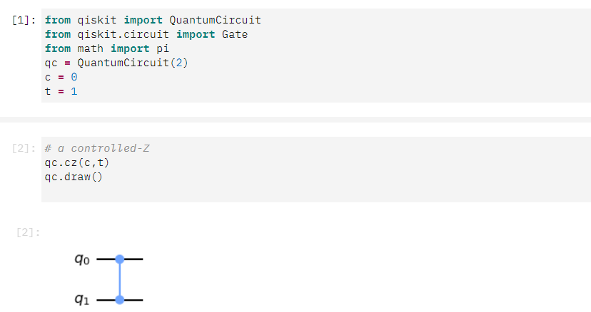
Implementation

Slide 22
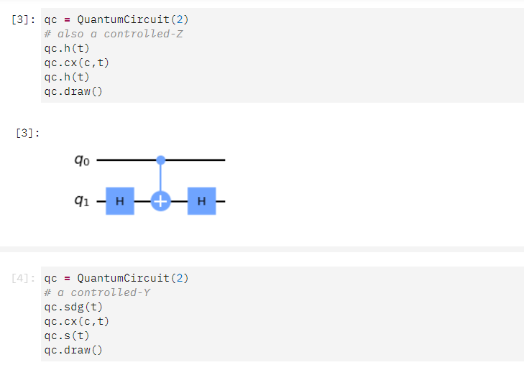

Slide 23
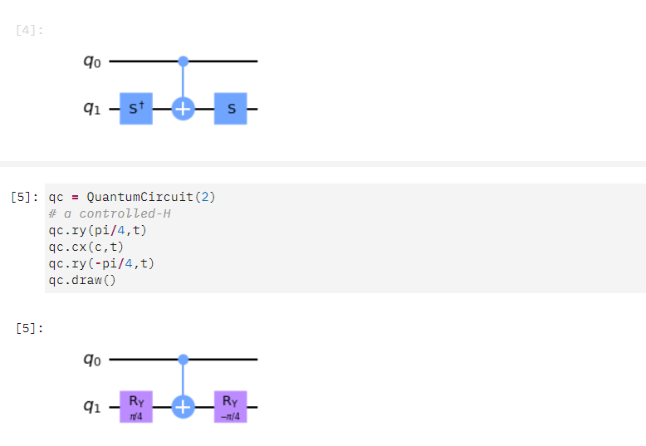

Slide 24
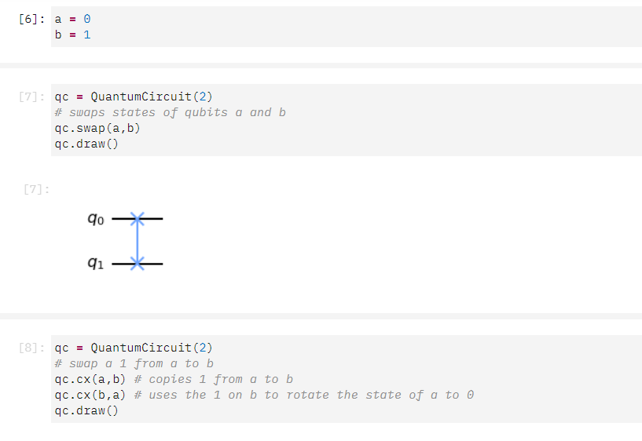

Slide 25
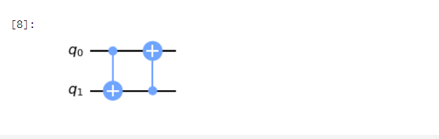
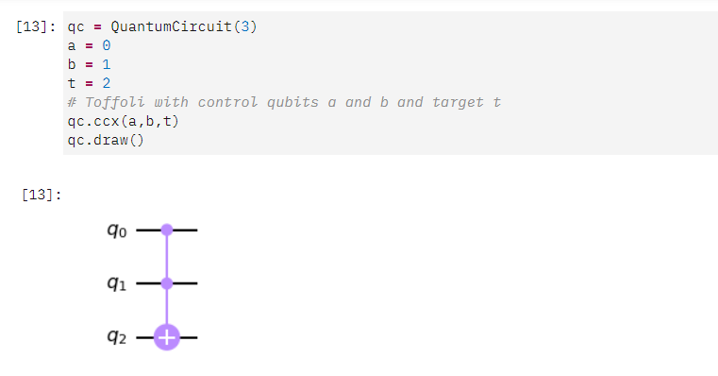

Slide 26
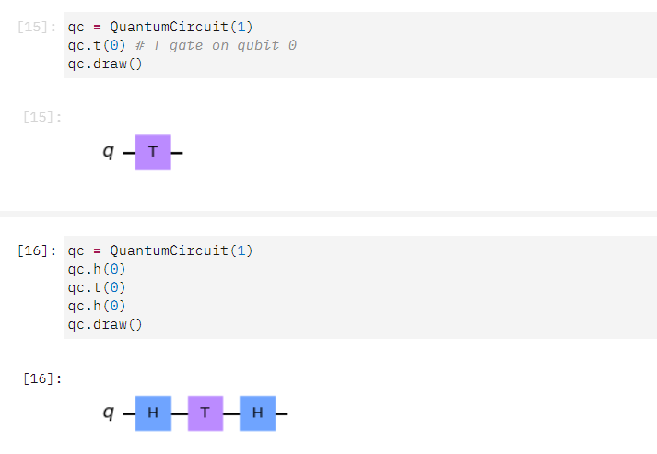

Slide 27
Thank You

